Slide 1
CHAPTER 7: Finite State Machine (FSM) Principle

Slide 2
Syllabus
Week | Content | Notes
1 | Chapter 0: Course Introduction (1) Chapter 1: Introduction to Digital Design (2)
2 | Chapter 2: Overview of HDL (3)
3 | Chapter 3: Basic Language Constructs of VHDL (3)
4, 5 | Chapter 4: Signal Assignment Statements of VHDL (6)
6 | Chapter 5: Combinational Logic Circuit Design (3)
7 | Midterm Exam (2)
8 | Chapter 6: Sequential Logic Circuit Design (3)
9, 10 | Chapter 7: Finite State Machine (FSM) Principle (6)

Slide 3
Content
Overview of FSMs
FSMs
FSMs in VHDL
Example
ASM Charts

Slide 4
1. Overview of FSM
Datapath vs. Controller
Structure of a Typical Digital System
Data Inputs
Control & Status Inputs
Control
Signals
Datapath
(Execution
Unit)
Controller
(Control
Unit)
Status
Signals
Data Outputs
Control & Status Outputs

Slide 5
1. Overview of FSM (Datapath – Execution Unit)
Manipulate and process data
Perform arithmetic and logic operations, shifting/rotating, and other data-processing
Composed of registers, multiplexers, adders, decoders, comparators, ALUs, gates, etc.
Provides all necessary resources and interconnects among them to perform specified task.
Interprets control signals from the controller and generates status signals for controller.

Slide 6
1. Overview of FSM (Controller Unit)
Controls data movement in the datapath by switching multiplexers and enabling or disabling resources.
  Example: Enable signals for registers
  Example: select signals for muxes
Provides signals to active various processing tasks in the datapath, i.e., +, -, or *, …
Determine the sequence of operations performed by the datapath
Follows some ‘program’ or schedule.

Slide 7
1. Overview of FSM (Controller Unit)
Controller can be programmable or non-programmable
Programmable
  Has a program counter which points to next instruction
  Instructions are held in a RAM or ROM
  Microprocessor is an example of programmable controller
Non-Programmable
  Once designed, implements the same functionality
  Another term is a “hardwired state machine”, or “hardwired FSM”, or “hardwired instructions”.
  In this course, we will be focusing on non-programmable controllers.

Slide 8
1. Overview of FSM
Controllers can be described as Finite State Machines (FSMs)
FSMs can be represented using
  State Diagrams and State Tables – suitable for simple controllers with a relatively few inputs and outputs
  Algorithmic State Machine (ASM) Charts
All of these descriptions can be easily translated to the corresponding synthesizable VHDL code.

Slide 9
1. Overview of FSM (Step of Design Process)
Text description
Define interface
Describe the functionality using pseudo-code
Convert pseudo-code to FSM in state diagram
  Define states and state transitions
  Define datapath operations in each state
Develop VHDL code to implement FSM
Develop testbench for simulation and debugging
Implementation and timing simulation
  Timing simulation can reveal more bugs and pre-synthesis simulation.
Test the implement on FPGA boards

Slide 10
2. FSMs
An FSM is used to model a system that transits among a finite number of internal states. The transitions depend on the current state and external input.
The main application of an FSM is to act as the controller of a medium to large digital system.
Design a FSMs involves
  Define states
  Define state transitions
  Define operations performed in each state
  Optimize/minimize FSM
Manual optimization/minimization is practical for small FSMs only.

Slide 11
2. FSMs (Moore FSM)
Output is a function of the present state only
Inputs
Next State
function
Next State
Present State
clock
State
register
reset
Output
function
Outputs

Slide 12
2. FSMs (Mealy FSM)
Output is a function of the present state and the inputs
Inputs
Next State
function
Next State
Present State
clock
State
register
reset
Output
function
Outputs

Slide 13
2. FSMs (State Diagrams)
Moore Machine
State operations: output assignments depends on the state
Transition conditions: Boolean expressions
transition condition 1
State 1 /
operations
State 2 /
operations
transition condition 2

Slide 14
2. FSMs (State Diagrams)
Mealy Machine
State operations: datapath operations including output assignments
Transition conditions: Boolean expressions
transition condition 1 /
datapath operations
State 1 /
operations
State 2 /
operations
transition condition 2 /
datapath operations

Slide 15
2. FSMs (Example 1)
Moore FSM that recognizes sequence “10”
0
1
0
S0 / 0
1
S1 / 0
S2 / 1
reset
1
0
S0: No
elements
of the
sequence
observed
S1: “1”
observed
S2: “10”
observed
Meaning
of states:

Slide 16
2. FSMs (Example 1)
Mealy FSM that recognizes sequence “10”
1 / 0
0 / 0
S0
S1
1 / 0
reset
0 / 1
S0: No
elements
of the
sequence
observed
S1: “1”
observed
Meaning
of states:

Slide 17
2. FSMs (Example 1)
clock
0 1 0 0 0
input
state
S0 S0 S1 S2 S0 S0
Moore
output
state
S0 S0 S1 S0 S0 S0
Mealy
output

Slide 18
2. FSMs (Moore vs. Mealy FSM)
Moore and Mealy FSMs are functionally equivalent.
  Equivalent Mealy FSM can be derived from Moore FSM and vice versa
Mealy FSM has richer description and usually requires less number states
  Smaller circuit area
Mealy FSM computes output as soon as inputs change
  Mealy FSM responds one clock cycle sooner than equivalent Moore
  FSM
  There are direct paths from inputs to outputs, may cause glitches.
Moore FSM has no combinational path between inputs and outputs.
  Less likely to affect the critical path of the entire circuit.

Slide 19
2. FSMs (Moore vs. Mealy FSM)
Which way to go?
Mealy FSM
Moore FSM
Fewer states
Safer.
Less likely to affect
the critical path.
Lower Area
Responds one clock
cycle earlier

Slide 20
3. FSMs in VHDL
FSMs can be easily described with processes.
Synthesis tools understand FSM description if certain rules are followed.
  State transitions should be described in a process sensitive to clock and asynchronous reset signal only.
  Output function described using rules for combinational logic, i.e., as concurrent statements or a process with all inputs in the sensitivity list.

Slide 21
3. FSMs in VHDL (Moore FSM)
process(clock, reset)
Inputs
Next State
function
Next State
clock
State
Register
Present State
reset
concurrent
statements
Output
function
Outputs

Slide 22
3. FSMs in VHDL (Mealy FSM)
process(clock, reset)
Inputs
Next State
function
Next State
Present State
clock
State
Register
reset
Output
function
Outputs
concurrent
statements

Slide 23
3. FSMs in VHDL (Moore FSM – Example 1)
Moore FSM that recognizes Sequence “10”
0
1
0
S0 / 0
1
S1 / 0
S2 / 1
1
reset
0

Slide 24
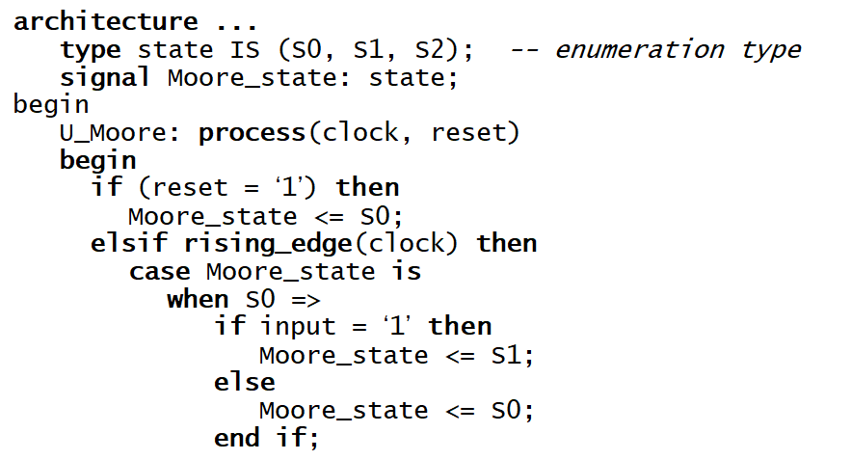
3. FSMs in VHDL (Moore FSM – Example 1)
0
S0 / 0
1
S1 / 0
next state logic

Slide 25
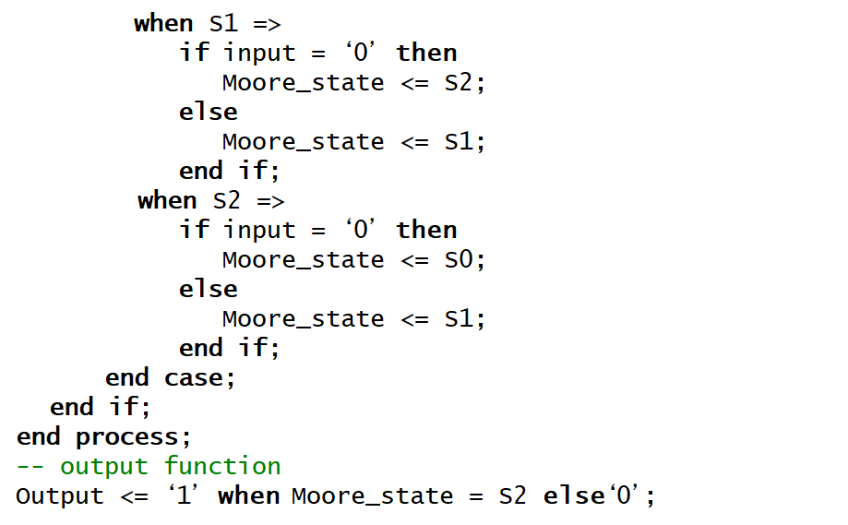
3. FSMs in VHDL (Moore FSM – Example 1)
next state logic

Slide 26
3. FSMs in VHDL (Mealy FSM – Example 1)
Mealy FSM that recognizes Sequence “10”
0 / 0
1 / 0
1 / 0
S0
S1
reset
0 / 1

Slide 27
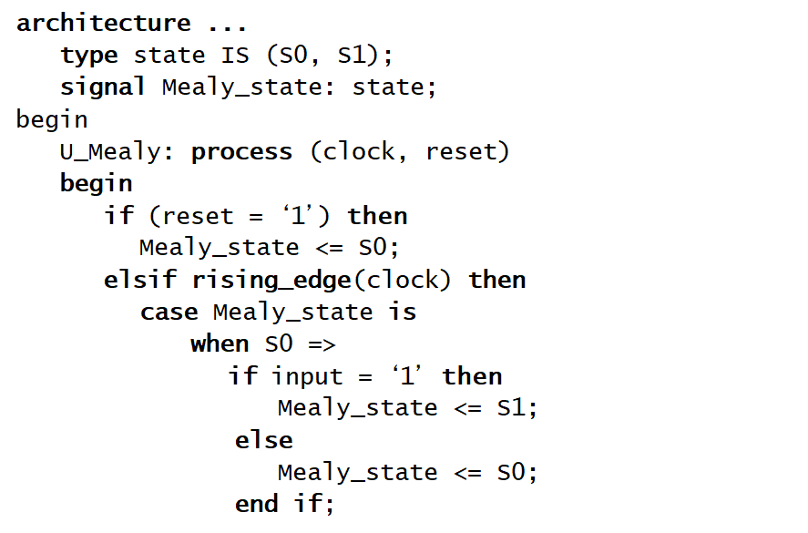
3. FSMs in VHDL (Mealy FSM – Example 1)
next state logic

Slide 28
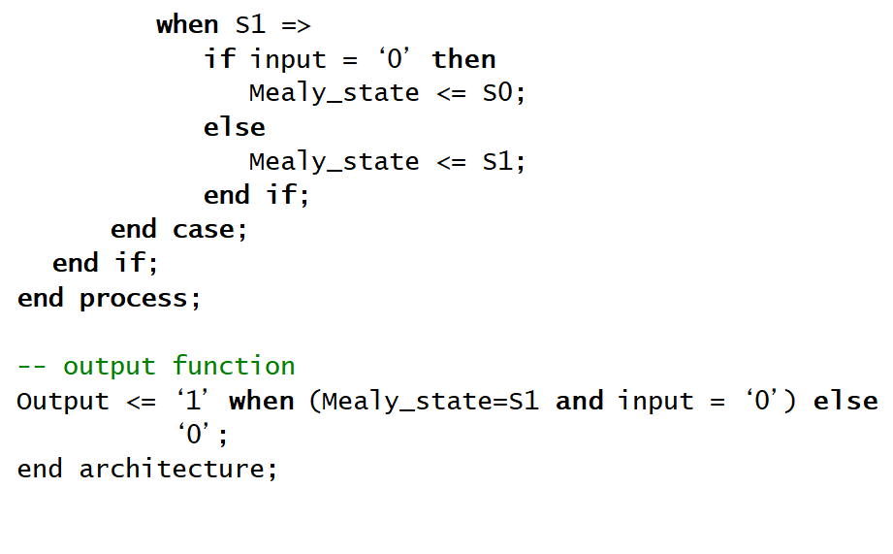
3. FSMs in VHDL (Mealy FSM – Example 1)
next state logic

Slide 29
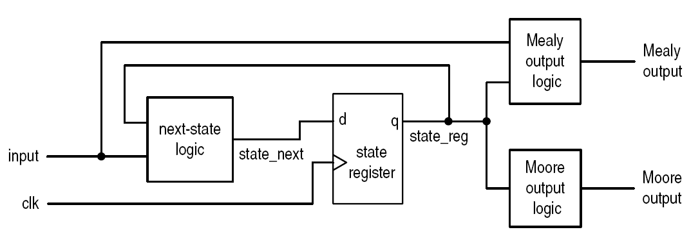
3. FSMs in VHDL
Generalized FSM

Slide 30
4. Example: Control Unit – Arbiter
reset
r1
g1
r2
Arbiter
g2
r3
g3
clock

Slide 31
4. Example: Control Unit – Arbiter

Slide 32
4. Example: Control Unit – Arbiter
ENTITY arbiter IS
PORT(Clock, Resetn : IN STD_LOGIC ;
r : IN STD_LOGIC_VECTOR(1 TO 3);
g : OUT STD_LOGIC_VECTOR(1 TO 3));
END arbiter;
ARCHITECTURE Behavior OF arbiter IS
TYPE State_type IS (Idle, gnt1, gnt2, gnt3);
SIGNAL state: State_type;
begin

Slide 33
4. Example: Control Unit – Arbiter
PROCESS(Resetn, Clock)
BEGIN
IF Resetn = '0' THEN
state <= Idle ;
ELSIF (Clock'EVENT AND Clock = '1') THEN
CASE state IS
WHEN Idle =>
IF r(1) = '1' THEN state <= gnt1 ;
ELSIF r(2) = '1' THEN state <= gnt2 ;
ELSIF r(3) = '1' THEN state <= gnt3 ;
ELSE state <= Idle ;
END IF ;
WHEN gnt1 =>
IF r(1) = '1' THEN state <= gnt1 ;
ELSE state <= Idle ;
END IF ;
-- continue on the next slide

Slide 34
4. Example: Control Unit – Arbiter
WHEN gnt2 =>
IF r(2) = '1' THEN state <= gnt2 ;
ELSE state <= Idle ;
END IF ;
WHEN gnt3 =>
IF r(3) = '1' THEN state <= gnt3 ;
ELSE state <= Idle ;
END IF ;
END CASE ;
END IF ;
END PROCESS ;
-- continue on the next slide

Slide 35
4. Example: Control Unit – Arbiter
-- output function
g(1) <= '1' WHEN y = gnt1 ELSE
'0’;
g(2) <= '1' WHEN y = gnt2 ELSE
'0’;
g(3) <= '1' WHEN y = gnt3 ELSE
'0’;
END architecture Behavior ;

Slide 36
4. Example: Fibonacci Number

Slide 37
4. Example: Fibonacci Number
rdy: input ready
done: result is available
i: running variable
n: number of iterations
t0: holds fib(i-2)
t1: holds fib(i-1)
idle/
rdy <=‘1’
done/
done <= ‘1’
i=1/
t1 <= 1
t0 <= 0
i>n
op
i<=n/
t1 <= t1+t0
t0 <= t1
i <= i+1

Slide 38
Differences: Signals vs. Variables
Variables can only de declared and used within processes or procedures.
  Used to hold temporary results
Signals can only be declared in architecture
  Used for inter-process communications
Variables are updated immediately
Signals are updated after current execution of a process is finished
Synthesis results:
  Variables: wires or nothing
  Signals: wires, registers, or latches

Slide 39
Differences: Signals vs. Variables
architecture sig_ex of test is
signal out1 : std_logic;
begin
process (clk)
begin
if rising_edge(clk) then
out1 <= a and b;
out2 <= out1 xor c;
end if;
end process;
end sig_ex;
a
b
AND
FF
out1
c
XOR
FF
out2

Slide 40
Differences: Signals vs. Variables
architecture var_ex of test is
begin
process (clk)
variable out3 : std_logic;
begin
if rising_edge(clk) then
out3 := a and b;
out4 <= out3 xor c;
end if;
end process;
end var_ex;
a
out3
b
AND
XOR
FF
out4
c

Slide 41
5. Algorithmic State Machine (ASM)
Algorithmic State Machine: representation of a Finite State Machine suitable for FSMs with a larger number of inputs and outputs compared to FSMs expressed using state diagrams and state tables.
State name
Output signals
0 (False)
Condition
1 (True)
Conditional outputs
or actions
expression
or actions (Mealy type)
(Moore type)
(a) State box
(b) Decision box
(c) Conditional output box

Slide 42
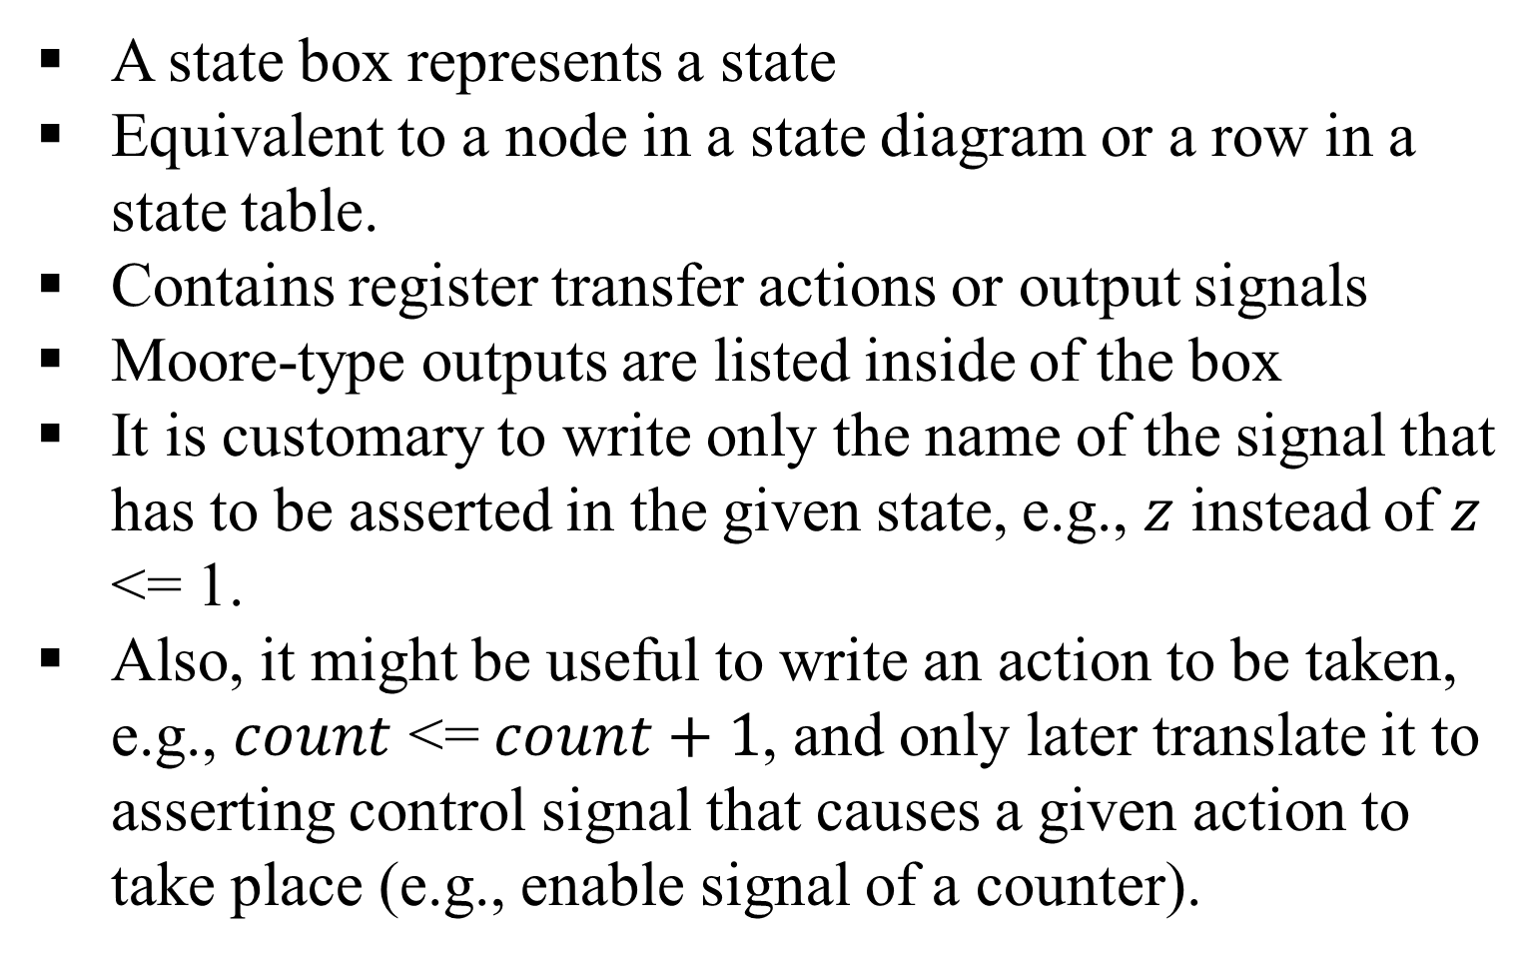
5. ASM: State Box
A state box represents a state
Equivalent to a node in a state diagram or a row in a state table.
Contains register transfer actions or output signals
Moore-type outputs are listed inside of the box
It is customary to write only the name of the signal that has to be asserted in the given state, e.g., $z$ instead of $z$ <= 1.
Also, it might be useful to write an action to be taken, e.g., $count$ <= $count+1$, and only later translate it to asserting control signal that causes a given action to take place (e.g., enable signal of a counter).
State name
Output signals
or actions
(Moore type)

Slide 43
5. ASM: Decision Box
A decision box indicates that a given condition is to be tested and the exit path is to be chosen accordingly.
The condition expression may include one or more inputs to the FSM.
0 (False)
Condition
1 (True)
expression

Slide 44
5. ASM: Conditional Output Box
A conditional output box denotes output signals that are of the Mealy type.
The condition that determines whether such outputs are generated is specified in the decision box.
Conditional outputs
or actions (Mealy type)

Slide 45
5. ASM: Moore FSM Example
ASMs can model both Mealy and Moore FSMs.
They also model machines that are of mix type.
Reset
w
=
1
w
=
0
A
⁄
z
=
0
B
⁄
z
=
0
w
=
0
w
=
0
w
=
1
C
⁄
z
=
1
Moore FSM: State Diagram
w
=
1

Slide 46
5. ASM: Moore FSM Example
Next state
Present
Output
state
z
w
=
0
w
=
1
A
A
B
0
B
A
C
0
C
A
C
1
Moore FSM: State Table

Slide 47
5. ASM: Moore FSM Example
Moore FSM: ASM Chart

Slide 48
5. ASM: Moore FSM Example
entity simple is
port( clock : in STD_LOGIC;
resetn : in STD_LOGIC;
w : in STD_LOGIC;
z : out STD_LOGIC);
end simple ;
architecture Behavior of simple is
type State_type IS (A, B, C) ;
signal state : State_type ;
begin
process( resetn, clock )
begin
if resetn = '0' then
state <= A ;
elsif rising_edge(Clock) then
Moore FSM: VHDL Code

Slide 49
5. ASM: Moore FSM Example
case state is
when A =>
if w = '0' then
state <= A ;
else
state <= B ;
end if;
when B =>
if w = '0' then
state <= A ;
else
state <= C ;
end if;
when C =>
if w = '0' then
state <= A ;
else
state <= C ;
end if;
end case;

Slide 50
5. ASM: Moore FSM Example
END IF;
END PROCESS;
z <= '1' when state = C else
'0’;
END Behavior;

Slide 51
5. ASM: Mealy FSM Example
Reset
w
=
1
⁄
z
=
0
A
B
w
=
0
⁄
z
=
0
w
=
1
⁄
z
=
1
w
=
0
⁄
z
=
0
Mealy FSM: State Diagram

Slide 52
5. ASM: Mealy FSM Example
Reset
w
=
1
⁄
z
=
0
A
B
w
=
0
⁄
z
=
0
w
=
1
⁄
z
=
1
w
=
0
⁄
z
=
0
Mealy FSM: ASM Chart

Slide 53
5. ASM: Mealy FSM Example
entity Mealy is
PORT ( clock : IN STD_LOGIC;
resetn : IN STD_LOGIC;
w : IN STD_LOGIC;
z : OUT STD_LOGIC);
end Mealy;
architecture Behavior of Mealy is
type State_type is (A, B) ;
signal state: State_type ;
begin
process (resetn, clock)
begin
if resetn = '0' then
state<= A ;
elsif rising_edge(clock) then

Slide 54
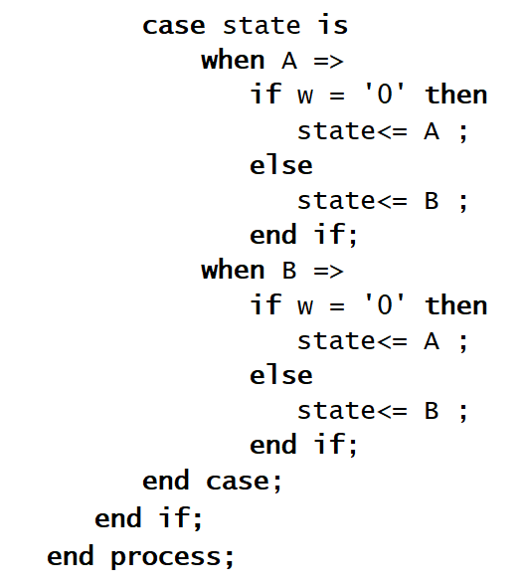
5. ASM: Mealy FSM Example
Reset
w
=
1
⁄
z
=
0
A
B
w
=
0
⁄
z
=
0
w
=
1
⁄
z
=
1
w
=
0
⁄
z
=
0

Slide 55
5. ASM: Mealy FSM Example
z <= '1' when (y = B) and (w=‘1’) else
'0’;
end architecture Behavior ;
Reset
w
=
1
⁄
z
=
0
A
B
w
=
0
⁄
z
=
0
w
=
1
⁄
z
=
1
w
=
0
⁄
z
=
0

Slide 56
5. ASM: Summary
ASM Chart
Flowchart-like diagram
Provides the same information as a state diagram
More descriptive, better for complex description
ASM block
  One state block
  One or more optional decision boxes:
  with T (1) or F (0) exit path
  One or more conditional output boxes:
  for Mealy output

Slide 57
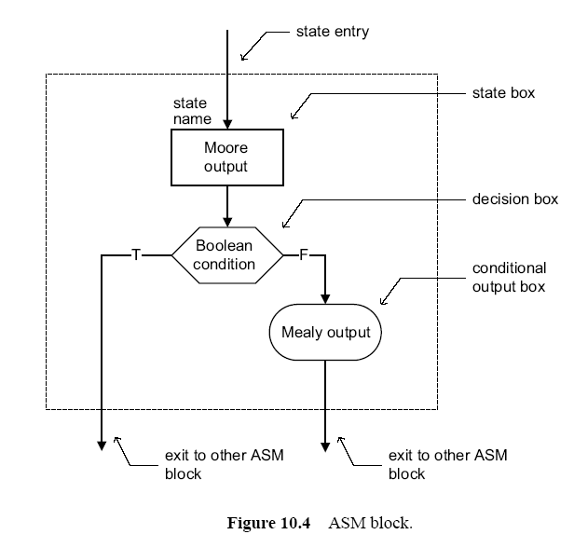
5. ASM: Summary

Slide 58
5. ASM: Chart Rules
Difference between a regular flowchart and an ASM chart
  Transition governed by clock
  Transition occurs between ASM blocks
Basic rules:
  For a given input combination, there is one unique exit path from the current ASM block
  Any closed loop in an ASM chart must include a state box.

Slide 59
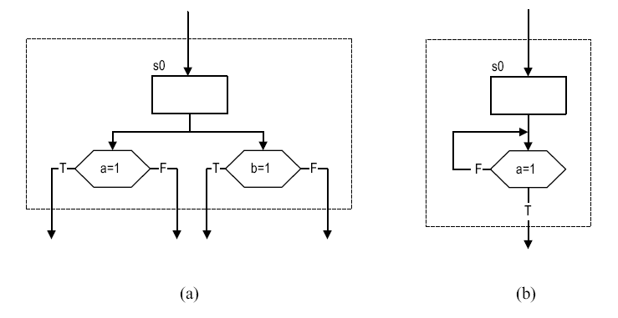
5. ASM: Incorrect ASM Chart

Slide 60
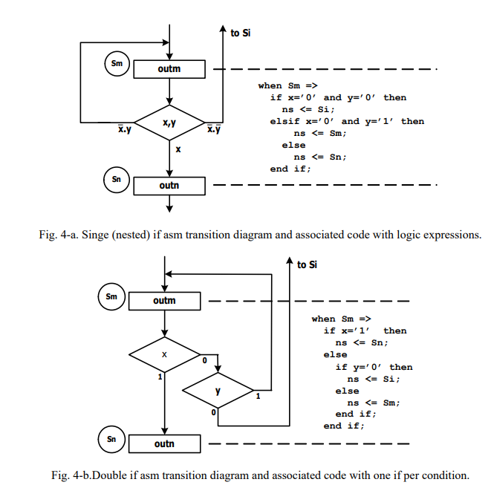
5. ASM: Incorrect ASM Chart

Slide 61
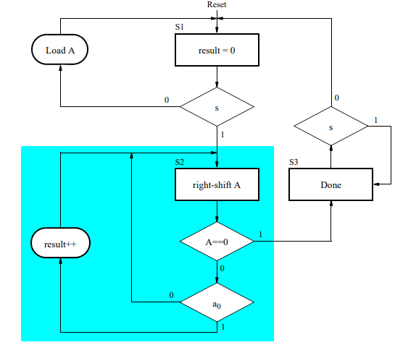
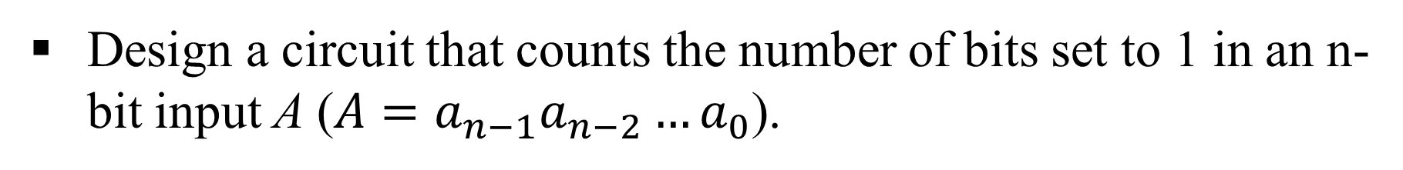
5. ASM: Example
Design a circuit that counts the number of bits set to 1 in an n-bit input A ($A=a_{n−1}a_{n−2}…a_{0}$).
S1 is the initial state, result = 0 and data is loaded into a register A until a start signal s, is asserted.
The ASM chart then transitions to state S2, where it increments the result to count the number of 1’s in register A.
When register A is equal to 0 the ASM chart transitions to state S3, where it sets an output Done = 1 and waits for the signal s to be deasserted
Is any problem with this design?

Slide 62
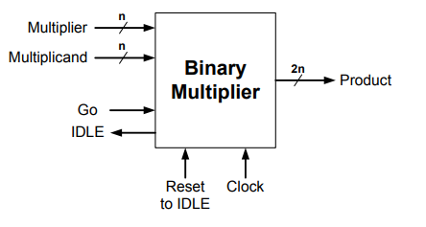
5. ASM: Example
Design a circuit that produces the 2n-bit product of two n-bit numbers placed on the Multiplier and Multiplicand inputs
Multiplication is initiated by the first clock pulse that occurs after the “Go” input is set HI
If the output IDLE= 1, the circuit is not busy, i.e. ready to multiply
While a multiply operation is taking place, IDLE = 0
These two signals (IDLE and Go) may be used to coordinate the timing of the binary multiplier with the external user. This is known as “handshaking”.
The Reset input is used to force the circuit (asynchronously) to the IDLE state at any time (such as at power-up)

